Slide 1
Aplastic Anemia
Authors: Dr. Nicola Goldberg & Dr. James Kennedy
Sunnybrook Health Sciences Centre

Slide 2
Learning Objectives:
1. Review the differential diagnosis and work-up of hypocellular bone marrow
2. Understand the diagnostic work-up and risk stratification of aplastic anemia
3. Review aplastic anemia management strategies based on disease severity and age/functional status

Slide 3
Case 1: 24F with pancytopenia
A 24F presents to the ER with a syncopal episode. Previously healthy, no past medical history. Recently has been well, with no viral URTI symptoms. She lives with her younger sister.
CBC:
Hb 57 g/L MCV 85 fL
WBC 2 x10⁹/L (ANC 0.1 x10⁹/L)
PLT 18 x10⁹/L
Reticulocytes 18 x10⁹/L

Slide 4
Case 1: 24F with pancytopenia
Further investigations:
• Prior CBC 2 years prior: normal
• No dysplasia or circulating blasts on blood film
• Normal hematinics, liver panel
• Viral serologies negative
• No hepatosplenomegaly on ultrasound

Slide 5
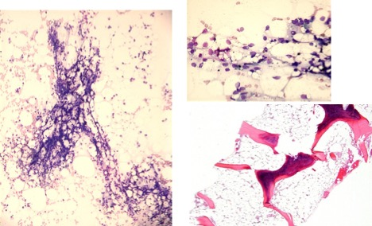
Case 1: Bone marrow results
Hypocellular marrow (10%) with maturing trilineage hematopoiesis with no significant dysplasia, no increase in blasts, MF0
Images courtesy of ASH Image Bank
Cytogenetics: 47, XX, +8 [3]; 46, XY [17]
NGS: BCOR (NM_0011233852] c.2514dup p.(K839Qfs*5), VAF 10%

Slide 6
QUESTION 1
What is the differential diagnosis of a hypocellular bone marrow?

Slide 7
BM biopsy is the gold standard for ascribing marrow cellularity
Expected cellularity: 100% - age
Beware suboptimal biopsies: subcortical marrow is hypocellular
Differential diagnosis of a hypocellular bone marrow
Aplastic anemia - idiopathic
- secondary to: - radiation
- chemotherapy
- chemical exposures (benzene) - idiosyncratic drug rxns (chloramphenicol, temozolamide et al.)
Anorexia nervosa
PNH
Hypocellular MDS
Inherited bone marrow failure syndromes

Slide 8
QUESTION 2
How do you diagnose Idiopathic Aplastic Anemia?
Are any additional investigations warranted in this case?

Slide 9
Idiopathic aplastic anemia is an immune-mediated process leading to the destruction of hematopoietic stem cells
Diagnosis of exclusion
Hypocellular marrow for age
Cytopenias
- 2 out of 3 of: Hb < 100 g/L; PLT < 50 x 10⁹/L; PMN < 1.5 x 10⁹/L
3) The ABSENCE of
Significant dysplasia
Abnormal marrow infiltrate
Increased reticulin fibrosis
4) No secondary cause
5) No evidence of an inherited bone marrow failure syndrome
Additional investigations
Flow cytometry for PNH
Workup for IBMFS
Chromosomal breakage
Telomere length testing
Genetic testing in select cases

Slide 10
QUESTION 3
Are you concerned by this patient’s cytogenetic and molecular abnormalities?
Could this be hypoplastic MDS?

Slide 11
Case 1: Bone marrow results
Hypocellular marrow (10%) with maturing trilineage hematopoiesis with no significant dysplasia, no increase in blasts, MF0
Images courtesy of ASH Image Bank
Cytogenetics: 47, XX, +8 [3]; 46, XY [17]
NGS: BCOR (NM_0011233852] c.2514dup p.(K839Qfs*5), VAF 10%

Slide 12
Clonality in idiopathic aplastic anemia
Contraction of the stem cell pool results in oligoclonality
Cytogenetics:
Majority of patients have normal karyotype at diagnosis
5-15% have abnormal karyotype, most frequently trisomies (chr 6,8) of small clone size
Other mutations:
Using standard myeloid gene panel: 1/3 of patients have mutations
Most frequently mutated genes:
BCOR (9%), BCORL1 (9%), DNMT3A (8%), ASXL1 (6%)
PIGA (7%) – leading to small PNH clones
Mutations at diagnosis tend to be present at low VAF (<10%)

Slide 13
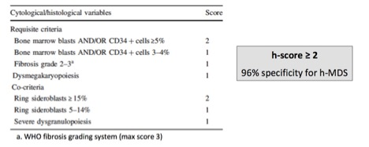
Key differential diagnosis of AA: hypoplastic MDS
10-15% of MDS is hypoplastic & its distinction from AA is challenging
Like AA, it can be associated with PNH clones and response to immunosuppression
LH-score – a cyto-histological score to distinguish these 2 entities:
Bono et al. Leukemia 2019:
Can cytogenetics / molecular help? Yes & no ….
Abnormal karyotype, large clones more common with hMDS
In hMDS: higher mutational burden (VAF, # mutations);
Certain mutations not seen in AA: spliceosome, RUNX1

Slide 14
QUESTION 4
How would you classify the severity of her aplastic anemia and why does it matter?

Slide 15
Grading the severity of AA
Severe aplastic anemia - Camitta criteria (1976):
BM cellularity < 25% or 25-50% with <30% residual hematopoietic cells
2 out of 3 of:
PMN < 0.5 x 10⁹/L
PLT < 20 x 10⁹/L
Reticulocytes < 60 x 10⁹/L (using an automated reticulocyte count)
Very severe aplastic anemia – Bacigalupo criteria (1988)
Same as Camitta for SAA, but PMN < 0.2 x 10⁹/L
SAA and VSAA merit immediate treatment

Slide 16
QUESTION 5
How would you treat her very severe aplastic anemia?

Slide 17
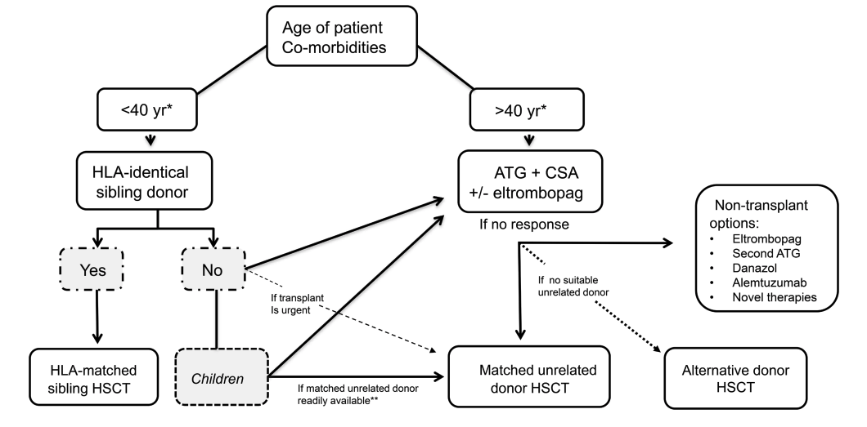
Severe Aplastic Anemia Management – 2023 Guidelines
Management is based on (1) severity (2) patient age/comorbidities (3) donor availability
Kulasekararaj et al. BJH 2023

Slide 18
Allo-transplant for Severe Aplastic Anemia – 2024 perspective
HSCT is a curative therapy, eliminates risk of clonal progression to MDS/AML (10-15% risk over 10 years)
Traditional first-line indication:
* SAA & age < 40 & HLA identical sibling donor
* BM is preferred stem cell source vs. PB
Transplant indications (and donor selection) are actively evolving
In children/adolescents <20 – matched unrelated donor is an option in the first line
For patients 40-50: first-line matched sibling donor may be considered based on comorbidities
There is encouraging emerging data for haplo-transplant in SAA
From 2023 Guidelines:
“the potential for cure with HSCT vs. IST should be discussed with patients when making
decisions re: first line therapy”
Kulasekararaj et al. BJH 2023

Slide 19
Case 1: Conclusion
Given that she is < 40 and classified as very severe, you test her sister who is found to be an identical HLA match, and thus she proceeds with an allogeneic stem cell transplant using marrow sourced stem cells.

Slide 20
Case 2: 54M with Petechiae
A 54 M goes to his GP with new petechiae on his ankles and progressive shortness of breath on exertion over the preceeding 2 months. He is not having infections. His past medical history is significant for hypertension, dyslipidemia, type 2 diabetes, atrial fibrillation, and gout. His medications include amlodipine, atorvastatin, valsartan, metformin, apixaban, and allopurinol. He is physically active, exercising at the gym 3 times per week and still working full-time as a plumber.
CBC:
Hb 88 g/L
MCV 104 fL
WBC 2.1 x10⁹/L (ANC 0.8 x10⁹/L)
Plt 14 x10⁹/L
Reticulocytes 12 x10⁹/L
Previous CBCs normal as recent as 6 months prior. No notable family history.

Slide 21
Case 2: 54M with Petechiae
You do an extensive work-up for pancytopenia.
There is a small PNH clone of 1.2% in the granulocytes, 0.8% in the monocytes.
Viral serologies normal
Ultrasound shows no hepatosplenomegaly
You do a bone marrow biopsy which is reported as a hypocellular for age (10%) with no dysplasia, blasts 1%, MF0. Cytogenetics are 46, XY and a myeloid NGS panel shows no pathogenic variants.
He is diagnosed with idiopathic severe aplastic anemia.

Slide 22
QUESTION 1
How would you manage this patient? Prior to deciding on treatment, what investigations should be performed to ensure his candidacy?

Slide 23
Severe Aplastic Anemia Management – 2023 Guidelines
No strict upper age limit for IST but used with caution > 60 y.o. require intact cardiac / renal function
Kulasekararaj et al. BJH 2023

Slide 24
QUESTION 2
What agents are used as first-line immunosuppressive therapy in aplastic anemia, and what are their unique toxicities and considerations?

Slide 25
Immunosuppressive Therapy for Severe Aplastic Anemia
Universally available approach in Canada: Equine ATG + cyclosporine
ATG: antithymocyte globulin
Polyclonal serum generated by immunizing horse with human T-cells
Dose: 40 mg/kg IV over 12h daily x 4 days
Infusion reactions are common (fever, hives, rigors, hypotension) that can progress to anaphylaxis – require premeds
Risk of serum sickness 1-2 weeks later (fever, rash, arthralgia/arthritis) → prophylaxis with prednisone
Cyclosporine A
Starting dose: 2.5 mg/kg BID - target trough level 150-400 ug/L
Continue at least 12 months until counts plateau, then slowly taper
Notable toxicities:
- renal dysfunction, electrolyte imbalances, HTN
- gingival hyperplasia, hirsutism
- immunosuppression
- neurotoxicity: tremors/headache → PRES/seizures
- rarely TMA

Slide 26
QUESTION 3
What response rates and timing of response are seen for equine ATG + cyclosporine?
What factors predict response to IST?

Slide 27
Immunosuppressive Therapy for Severe Aplastic Anemia
Universally available approach in Canada: Equine ATG + cyclosporine
Response in 2/3 patients
Takes average of ~3 months
1/3 of responders relapse by 5 years
Predictors of response to IST ¹
Young age
Higher baseline reticulocytes (>25 x 10⁹)
Higher baseline lymphocytes (>1 x 10⁹)
PIGA and BCOR/BCORL1 mutations ²
1. Schienberg et al BJH Blood 2009
2. Yoshizato et al NEJM 2015

Slide 28
QUESTION 4
Are there any add-ons to equine ATG + cyclosporine that can ameliorate response rates and/or speed up the time to response?

Slide 29
Addition of eltrombopag to standard IST for severe AA
Phase 3 RACE trial: De Latour et al NEJM 2022
Equine ATG + cyclosporine +/- eltrombopag (starting on day 14 for 3-6 months)
Inclusion: SAA, previously untreated (n=197)
- CR at 3 months: 22% vs. 10%
ORR at 6 months: 68% vs. 41%
Shorter time to first response
Similar OS
No signal for increased clonal evolution with ELT to date
Increased fibrosis with rare ELT cases

Slide 30
Case 2 Continued
He receives ATG and is started on cyclosporine. His counts respond and he goes into remission. You follow him every month for the first year.
At 12 months, he tells you he feels quite jittery and wants to know if this could be a side effect of any of his medications, and what can be done. His counts have plateaued with a recent CBC showing Hb 112, WBC 5 (ANC 2), Platelets 120.

Slide 31
QUESTION 5
How do you explain his symptoms and what would you do next?

Slide 32
Cyclosporine tapering strategies
Given 12 months of CsA and plateaued counts, reasonable to start slow taper
One approach: decrease by 25 mg q2-3 months
Many patients are unable to completely stop CsA, but majority re-respond if dose is re-increased to prior effective levels

