Slide 1
Inherited Bone Marrow Failure Syndrome (IBMFS) Workshop
Author: Dr. Amy Trottier, Dalhousie University
Editors: Dr. James Kennedy, Dr. Nicola Goldberg

Slide 2
Learning Goals
Understand common presentations of inherited bone marrow failure syndromes
2) Understand the work-up and diagnostic tests for inherited bone marrow failure syndromes
3) Introduction to the management bone marrow failure syndromes (focus on Fanconi Anemia and Telomere Biology Disorders)

Slide 3
CASE 1: MILD PANCYTOPENIA AND HYPOPLASTIC THUMBS
A 20 year old University student had blood work done through her family physician after a pre-syncopal episode while in class. Her CBC was as follows:
Hemoglobin 131 g/L, RBC 3.71 x10¹²/L, MCV 104.9 fL
WBC 3.75 x10⁹/L
Neutrophils 1.39 x10⁹/L
Remainder of differential was normal
PLTs 79 x10⁹/L
Reticulocytes 32 x10⁹/L
Aside from macrocytosis there were no morphologic abnormalities on the peripheral smear. Additional work-up including retics, TSH, liver enzyme and function tests, Vit B12, folate, ferritin, Cr, lytes were all normal. A CBC 2 years prior had also shown macrocytosis and mild thrombocytopenia (Hb 145 g/L; MCV 102.1; WBC 6.0 x109/L, PMN 4.1 x109/L; PLT 112 x109/L). It had not been investigated at that time.
She was referred to hematology for additional work-up.

Slide 4
CASE 1: MILD PANCYTOPENIA AND HYPOPLASTIC THUMBS
The patient was feeling well with no current symptoms or complaints. No further pre-syncopal episodes. No prior history of infection or abnormal bleeding or bruising. No constitutional symptoms. She was a dean’s list undergraduate BSc student. Past medical history significant for a hypoplastic left thumb requiring plastic surgery on the tendons at age 3 years. No family history of cytopenias. Her mother was recently diagnosed with polycythemia vera. No family history of solid tumor malignancies. She takes no medications, does not smoke, drink alcohol, or use recreational drugs.
On examination the patient was of short stature and low BMI: height 157cm, weight 42.8kg, BMI 17.2 (of note her mother that came with her was 177cm tall). She had bilateral hypoplastic thumbs. There were two hypopigmented spots on her left arm. Otherwise her examination was unremarkable.

Slide 5
CASE 1: MILD PANCYTOPENIA AND HYPOPLASTIC THUMBS
You do a bone marrow aspirate & biopsy and it shows the following:
MODERATELY HYPOCELLULAR MARROW FOR AGE (40%) WITH TRILINEAGE HEMATOPOIESIS. NO INCREASE IN BLASTS. NO SIGNIFICANT DYSPLASIA. NO VARIANTS IDENTIFIED IN MYELOID MDS NGS PANEL. NORMAL FEMALE KARYOTYPE (46, XX [20]).

Slide 6
QUESTION 1:
WHAT ARE INHERITED BONE MARROW FAILURE SYNDROMES (IBMFS)? WHAT FINDINGS IN THIS CASE POINT TOWARDS AN IBMFS?

Slide 7
IBMFS are rare congenital disorders characterized by cytopenias / marrow hypocellularity / an increased risk of progression to MDS/AML, and are often accompanied by non-hematopoietic manifestations (congenital malformations, organ impairment, solid tumor development) IBMFS are caused by inherited mutations in an array of different genes and display different inheritance patterns Commonly encountered IBMFS in adult hematology practice include:
Genes
Inheritance
FA family
AD / AR / XL
Telomerase
complex
AD /AR
SBDS
AR
Park Blood Res 2022

Slide 8
Clues to IBMFS in this case:
- cytopenia / macrocytosis onset at young age with progression over time
- hypocellular bone marrow, often a non-severe aplastic anemia picture
- congenital malformations (hypoplastic thumbs)
Additional features of IBMFS not present in this case:
- family history of aplastic anemia / MDS / AML
- personal / family history of other cancers (ex: H/N or anogenital SCC common in DKC / FA
- non-hematopoietic organ involvement
- pancreatic insufficiency (SDS)
- cirrhosis / pulmonary fibrosis (DKC)

Slide 9
QUESTION 2
HOW DO YOU DO TO WORK UP THIS PATIENT’S BONE MARROW FAILURE?

Slide 10
Not your typical history / physical exam
Comprehensive personal and family history (2 generations at least) with focus on hematologic issues, congenital anomalies, solid tumors and organ dysfunction
Head to toe physical exam
‘Directed’ Workup for IBMFS:
1. Hemoglobin electrophoresis (see elevated HbF % in IBMFS (and AA))
2. Flow for PNH (IBMFS essentially always negative for PNH clone)
3. Chromosomal breakage analysis (screen for Fanconi anemia)
4. Telomere length analysis (screen for Telomere biology disorders / Dyskeratosis congenita)
5. Genetic testing

Slide 11
This patient’s chromosome breakage/fragility test results:
Breaks/cell | 0 DOSE | MMC | DEB
Patient | 12/50 (0.24) | 62/50 (1.24) | 70/50 (1.4)
Control Range | 0.00-0.08 | 0.00-0.12 | 0.00-0.12
FA Range | 0.06-0.48 | 0.38-3.04 | 0.78-3.92

Slide 12
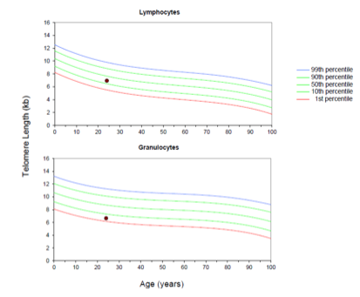
This patient’s telomere length analysis:

Slide 13
QUESTION 3
BASED ON THESE RESULTS WHAT IS YOUR PREFERRED DIAGNOSIS?
WHAT CONFIRMATORY TEST SHOULD BE PERFORMED NEXT?

Slide 14
This patient’s chromosome breakage/fragility test results:
Breaks/cell | 0 DOSE | MMC | DEB
Patient | 12/50 (0.24) | 62/50 (1.24) | 70/50 (1.4)
Control Range | 0.00-0.08 | 0.00-0.12 | 0.00-0.12
FA Range | 0.06-0.48 | 0.38-3.04 | 0.78-3.92
Increased rates of spontaneous (0 dose) and MMC/DEB-induced chromosomal breaks
POSITIVE screen for Fanconi anemia

Slide 15
Genetic testing caveats
1) ‘myeloid’ NGS panels done for MDS/MPN/AML do not assess majority of the genes associated with iBMFS
2) comprehensive testing for iBMFS available through commercial gene panels (provincially funded panels are on the way)
3) ideal material for germline testing: skin fibroblast DNA - not DNA from PB/BM
confirms ‘germline’ transmission as mutations in blood could be somatically acquired
somatic reversion can occur in the blood – leading to false negatives

Slide 16
This patient’s results:
Heterozygous for FANCA c.3605_3607del, p.Glu1202del (likely pathogenic)
Heterozygous for FANCA c.2606A>C, p.Gln869Pro (likely pathogenic)
Fanconi anemia is caused by loss of function mutations in over 22 different genes involved in DNA repair (FANCA to FANCW)
Majority of cases are inherited in an autosomal recessive manner (FANCA – 60%; FANCC – 10-15%; FANCG – 10%)
This patient is a compound heterozygote for loss-of-function mutations in FANCA

Slide 17
QUESTION 4
WHAT ARE THE POSSIBLE CLINICAL MANIFESTATIONS OF FANCONI ANEMIA?

Slide 18
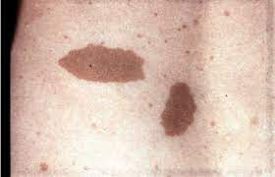
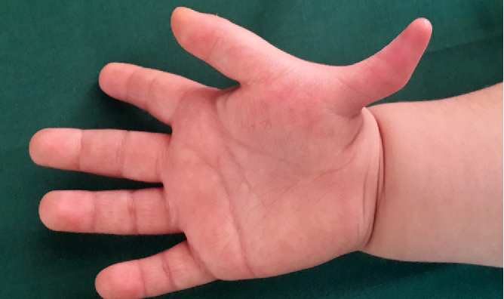
Hematologic:
pancytopenia / progressive aplastic anemia
30% risk of MDS / AML by 50 y.o
Congenital anomalies (~2/3 patients):
short stature, low birth weight, developmental delay
skin (café au lait spots; hypo/hyperpigmentation)
thumb / radial ray abnormalities
kidney, cardiac, GI tract anomalies
Solid tumors:
10% risk by age 50
most commonly H/N, anogenital squamous cell cancers
FANCD1 (BRCA2) / FANCS (BRCA1): increased risk of breast / ovarian cancer

Slide 19
QUESTION 5
HOW DO YOU TREAT/MANAGE PATIENTS WITH FANCONI ANEMIA?

Slide 20
Multidisciplinary approach: hematology/BMT, genetic counselling, dermatology, dentistry, ENT, Gyne, plastic surgery
From hematology standpoint: main issue is pancytopenia that can progress to MDS/AML
Monitoring:
CBC q3 months
Bone marrow: at baseline then at least yearly
Interventions:
Bone marrow transplant (unaffected sibling, BM source – for severe BMF, MDS/AML
Androgens (danazol / oxymetholone)
Growth factors (G-CSF)
Additional surveillance:
ENT / dental assessments q6 months
Dermatology yearly
Endocrine: TSH, A1C yearly
Gynecology / Pap smears
Vaccinations: HPV & others as per guidelines
Additional screening depending on genetic subtype
Guidelines are available from the Fanconi Anemia Foundation: https://fanconi.org/clinical-care-guidelines/clinical-care/

Slide 21
CASE 2: “Asthma”, Fatigue, and Bicytopenia
A 35 year old male presented to his family physician with chronic fatigue. A CBC showed macrocytic anemia and thrombocytopenia.
Hemoglobin 117 g/L, MCV 109.8 fL
WBC 3.07 x10⁹/L
Neutrophils 2.09 x10⁹/L
Remainder of diff was normal
PLTs 69 x10⁹/L
Reticulocytes 37 x10⁹/L
He was referred to hematology for further evaluation. Aside from macrocytosis there were no morphologic abnormalities on the peripheral smear. Additional work-up including TSH, liver enzyme and function tests, Vit B12, folate, ferritin, Cr, lytes were all normal.

Slide 22
CASE 2: “Asthma”, Fatigue, and Bicytopenia
Aside from chronic fatigue, he has generally been feeling well. Past medial history is significant for life-long mild asthma with use of Ventolin on a PRN basis. No spontaneous bleeding but easy bruising his entire life. He was diagnosed with diabetes, type 2, at age 20 and is on metformin. He is a smoker and drinks socially. His family history is significant for pulmonary fibrosis in his mother and a maternal uncle as well as and older sister that passed away at the age of 32 from oral squamous cell cancer.
On examination, the patient was of 178 cm tall and weighed 65.9kg. A head to toe examination was completed and the only remarkable findings were scattered fine crackles at the lung bases and significant greying of the hair.

Slide 23
CASE 2: “Asthma”, Fatigue, and Bicytopenia
You do a bone marrow biopsy and it shows the following:
-Hypocellular marrow (20-30% cellularity) with decreased trilineage hematopoiesis and no significant dysplastic changes. There is no increase in blasts and no lymphoid aggregates seen.
-Cytogenetics: 46 XY [20]
-Myeloid NGS: No variants identified.

Slide 24
QUESTION 1
HOW DO YOU DO TO WORK UP THIS PATIENT’S BONE MARROW FAILURE?

Slide 25
Not your typical history / physical exam
Comprehensive personal and family history (2 generations at least) with focus on hematologic issues, congenital anomalies, solid tumors and organ dysfunction
Head to toe physical exam
‘Directed’ Workup for IBMFS:
1. Hemoglobin electrophoresis (see elevated HbF % in IBMFS (and AA))
2. Flow for PNH (IBMFS essentially always negative for PNH clone)
3. Chromosomal breakage analysis (screen for Fanconi anemia)
4. Telomere length analysis (screen for Telomere biology disorders / Dyskeratosis congenita)
5. Genetic testing

Slide 26
This patient’s chromosome breakage/fragility test results:
Breaks/cell | 0 DOSE | MMC | DEB
Patient | 3/50 (0.06) | 1/50 (0.02) | 1/50 (0.02)
Control Range | 0.00-0.08 | 0.00-0.12 | 0.00-0.12
FA Range | 0.06-0.48 | 0.38-3.04 | 0.78-3.92

Slide 27
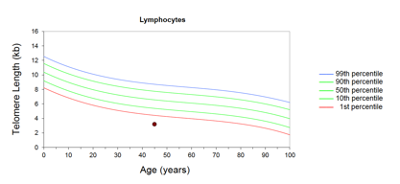
This patient’s telomere length analysis:
BASED ON THESE RESULTS WHAT IS YOUR LEADING DIAGNOSIS?

Slide 28
QUESTION 2
HOW DO YOU DIAGNOSIS TELOMERE BIOLOGY DISORDERS (TBD)?

Slide 29
SCREENING TEST: Lymphocyte telomere length analysis
Age-adjusted lymphocyte telomere length <1rst percentile is highly sensitive and specific for Telomere Biology Disorders
Short telomeres in granulocytic lineage: less sensitive (also seen in idiopathic AA)

Slide 30
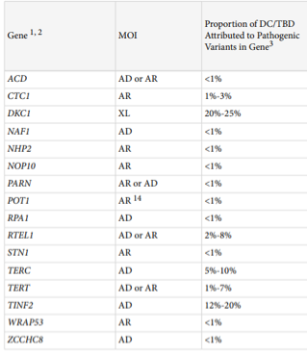
Numerous genes are implicated in telomere biology disorders
CONFIRMATORY TEST: Genetic testing (preferably from skin fibroblast DNA)
Form parts of the telomerase complex responsible for telomere preservation
Savage and Niewisch GeneReviews 2023

Slide 31
This patient’s results:
Heterozygous for TERC n.437T>G (likely pathogenic)
Inheritance of TERC is autosomal dominant

Slide 32
QUESTION 3
WHAT ARE THE POSSIBLE CLINICAL MANIFESTATIONS OF DYSKERATOSIS CONGENITA/TELOMERE BIOLOGY DISORDERS?

Slide 33
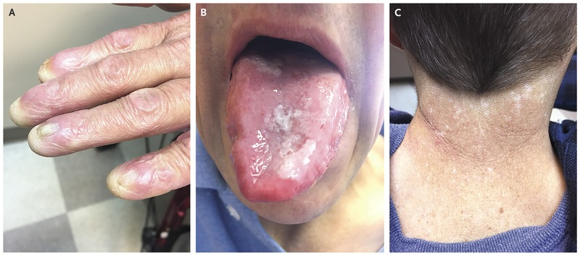
Classic triad: skin pigmentation, oral leukoplakia, nail dystrophy
Hematologic: NSAA → MDS/AML
Non-hematologic manifestations (highly variable)
Lung: pulmonary fibrosis
Liver: cirrhosis
Solid tumors: skin, squamous cell carcinomas of oro/nasopharynx, anogenital region
Eye: lacrimal duct stenosis, eyelash pathology
Bone: osteoporosis / osteonecrosis
Prematuring greying of hair

Slide 34
QUESTION 4
HOW DO YOU TREAT/MANAGE PATIENTS WITH TELOMERE BIOLOGY DISORDERS?

Slide 35
Multidisciplinary approach: hematology/BMT, genetic counselling, dermatology, dentistry, ENT, Respirology, Hepatology
Baseline investigations:
CBC, bone marrow examination with cytogenetics / molecular
Pulmonary function tests; high resolution CT chest if abnormal
Liver ultrasound / Fibroscan
Bone mineral density testing
From hematology standpoint: main issue is pancytopenia that can progress to MDS/AML
Monitoring: CBC q3 months ; bone marrow exam repeated if worsening cytopenias, evidence of disease evolution
Interventions:
Bone marrow transplant is only cure – for severe BMF, MDS/AML
Androgens (danazol) can improve cytopenias (response in 80%, do not delay/promote MDS/AML)
Additional surveillance:
Hepatology: yearly liver enzymes/function; fibroscan q2-3 years
ENT/Dentist: annual exam
Dermatology: annual exam
Gynecology / Pap smears
Guidelines are available: teamtelomere.org
Respirology: minimum PFTs q3 years
Bone: DEXA q5 years
Vaccinations: HPV and others as per guidelines

