Slide 1
Paroxysmal Nocturnal Hemoglobinuria (PNH)
Case Author: Monika Oliver, BSc MD FRCPC. University of Alberta, Division of Hematology
Editors: James Kennedy, Nicola Goldberg

Slide 2
Learning Objectives:
1. To provide an overview of the pathophysiology, clinical presentation, and diagnosis of Paroxysmal Nocturnal Hemoglobinuria (PNH), including the role of complement dysregulation and its impact on red blood cell destruction.
2. To review common reasons for diagnostic delay and the “CATCH” criteria
3. To familiarize participants with the diagnostic tools and techniques used in the evaluation of PNH, such as flow cytometry
4. To review the principles of PNH management, including supportive care measures, pharmacologic interventions such as anti-complement therapy, and potential considerations for hematopoietic stem cell transplantation.

Slide 3
Case 1:
A 34-year-old male presents to his primary care physician with complaints of fatigue, decreased exercise stamina, and erectile dysfunction over the past few months. On review of systems, he reports a history of frequent episodes of crampy abdominal pain, particularly after meals. His past medical history is remarkable only for anxiety and he is on no medications.
The patient denies any overt bleeding but does report dark-red-appearing urine, most prominent upon waking. He eats a typical diet and has no other symptoms compatible with malabsorption.
His physical exam reveals pale conjunctiva and sclera but is otherwise within normal limits.

Slide 4
Case 1:
Laboratory investigations reveal:
Hemoglobin level of 99 g/L (normal range: 135-175 g/L)
Mean corpuscular volume (MCV) of 90 fL (normal range: 80-100 fL)
Absolute reticulocyte count of 224 × 109/L
Platelet and white blood cells are within normal limits
Ferritin low at 11 μg/L (normal range: >20 μg/L)
Vitamin B12 and folate are within normal limits.
Creatinine, thyroid function & liver enzymes within normal limits
Total bilirubin is elevated at 30 umol/L (normal <20umol/L)
Urinalysis positive for hemoglobinuria
Screening for sexually transmitted infections (STIs) is negative.

Slide 5
Case 1:
The primary care physician initiates oral iron supplementation and requests a stool sample for occult blood as well as a celiac screen.
An ultrasound of the abdomen including kidneys and bladder is ordered.
She makes a referral to Gastroenterology for consideration of endoscopy as well to Urology for the complaint of erectile dysfunction and presumed hematuria.

Slide 6
QUESTION 1
Do you agree with the above work-up and referrals? What additional testing or history would you have requested if this patient presented to you?

Slide 7
Suspicion of hemolytic process:
Peripheral blood smear
LDH, haptoglobin, fractionated bilirubin
Direct antiglobulin test
Additional urine studies: urine hemosiderin, urine cytology
Notes:
Source: The Blood Project

Slide 8
Case 1 Continued:
The patient is seen by gastroenterology and a colonoscopy is performed which is unremarkable. Urologist concludes that the dark red urine is in fact hemoglobinuria and not hematuria and does not have a clear explanation for the patients erectile dysfunction.
Additional investigations requested upon follow-up with the FP several months later:
CBC at this visit now shows Hg 86g/l, Normal platelets, WBC & differential
Abdominal US + KUB: unremarkable
Anti-TTG negative, immunoglobins normal

Slide 9
Case 1 Continued:
LDH 980U/L (normal range: 100-250 U/L)
Haptoglobin undetectable (normal range: 0.3-2.0 g/L)
Indirect bilirubin 22 umol/L, direct bilirubin 8 umol/L (normal range: < 3.0 umol/L)
Peripheral blood smear: Increased presence of polychromatic red blood cells and anisocytosis. No evidence of spherocytes or schistocytes. Normal WBC and platelet morphology.
HIV, HBV, HCV serologies negative
DAT (Coombs test): negative
Iron 3, TIBC 52, Tsat 0.05
Positive urine dipstick for hemoglobin. Urine microscopy does not show RBCs, but is positive for the presence of hemosiderin. Urine cytology shows no malignant cells.

Slide 10
QUESTION 2
What is your differential diagnosis at this time for the patients DAT negative hemolysis? What laboratory testing do you request to confirm your suspected diagnosis?

Slide 12
QUESTION 3a:
What is Paroxysmal Nocturnal Hemoglobinuria (PNH)? Please review the pathophysiology including the two most important glycosylphosphatidylinositol (GPI)-anchored complement proteins involved in the disease. What single test confirms the diagnosis of PNH?

Slide 13
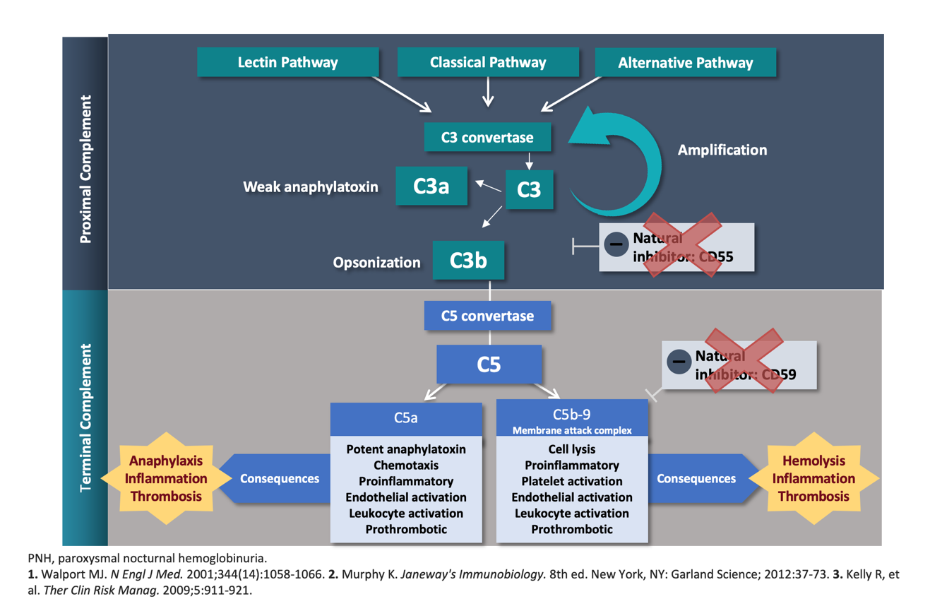
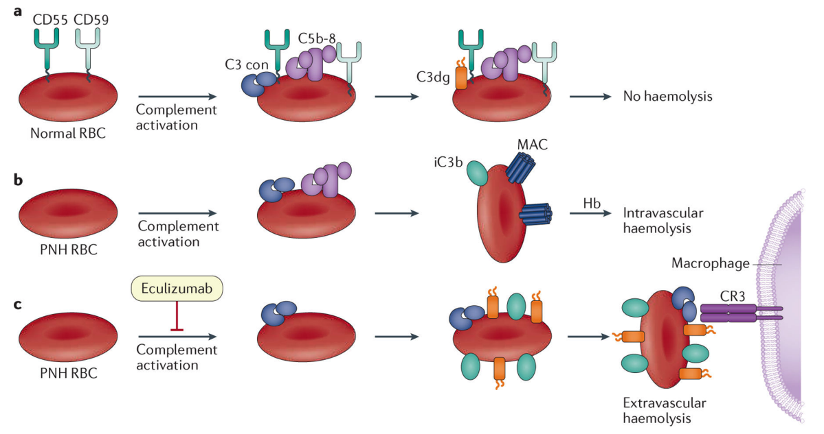
PNH arises from acquired mutations in PIGA – leads to absence of GPI-anchored proteins most notably CD55 & CD59
that normally serve to regulate the complement pathway and protect RBCs from MAC-mediated hemolysis
Hill et al. Nat Rev Dis Primers 2017

Slide 14
PNH Diagnosis by Flow Cytometry
Looks for absence of GPI anchored proteins
NORMAL
PNH
CD157
WBCs
FLAER
Fluorescent-labelled aerolysin
- binds to GPI anchor
CD59
RBCs
3
2
1
Adapted from wardelab.com

Slide 15
QUESTION 3b:
Which cell population provides the most accurate measurement of the PNH clone size? What clone size is generally considered clinically significant?

Slide 16
Hemolysis and transfusion render RBC population unreliable measure of PNH clone size
Granulocyte/monocyte clones < 10% are typically not associated with clinically significant hemolysis or PNH manifestations

Slide 17
QUESTION 4:
What potential signs and symptoms do patients with PNH present with? Why may patients with PNH experience a delay in diagnosis?

Slide 18
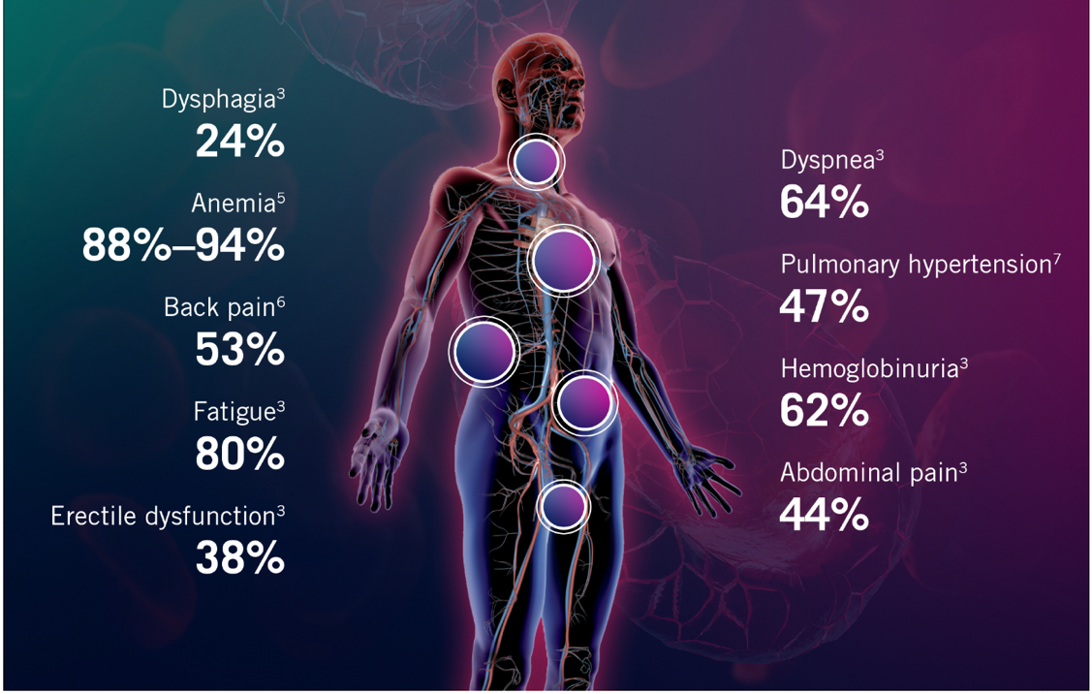
PNH Signs and Symptoms

Slide 19
QUESTION 5:
What are the CATCH Criteria?

Slide 20
CATCH Criteria

Slide 21
Case 2:
A previously healthy 35-year-old female presents to the ED for evaluation of severe abdominal pain and red urine which has developed over the past 5 days. She currently is taking an oral contraceptive but is on no other medications.
Her examination is significant for mild scleral icterus and jaundice. There is no abdominal or costovertebral tenderness on exam. The remainder of the exam is unremarkable.
Laboratory studies are significant for a hemoglobin level of 79 g/L with an absolute reticulocyte count of 267 × 109/L. White blood cell count and platelet count are slightly decreased. Indirect bilirubin is elevated at 72 μmol/L, but alanine transaminase (ALT), and alkaline phosphatase are normal. Lactate dehydrogenase (LDH) is also increased at 1,024 U/L and haptoglobin is undetectably low. Blood bank evaluation confirms the DAT is negative.
Abdominal imaging reveals mesenteric vein thrombosis. She is anticoagulated with low molecular weight heparin, leading to clinical improvement of her abdominal pain. She has no prior or family history of thrombosis.
The patient is referred to hematology and a diagnosis of PNH is made based on high sensitivity flow cytometry with confirms a granulocyte clone size of 88% and a monocyte clone size of 82%.

Slide 22
Question 1:
In addition to anticoagulation as above, what urgent management do you suggest? What is the mechanism of action of this treatment?

Slide 23
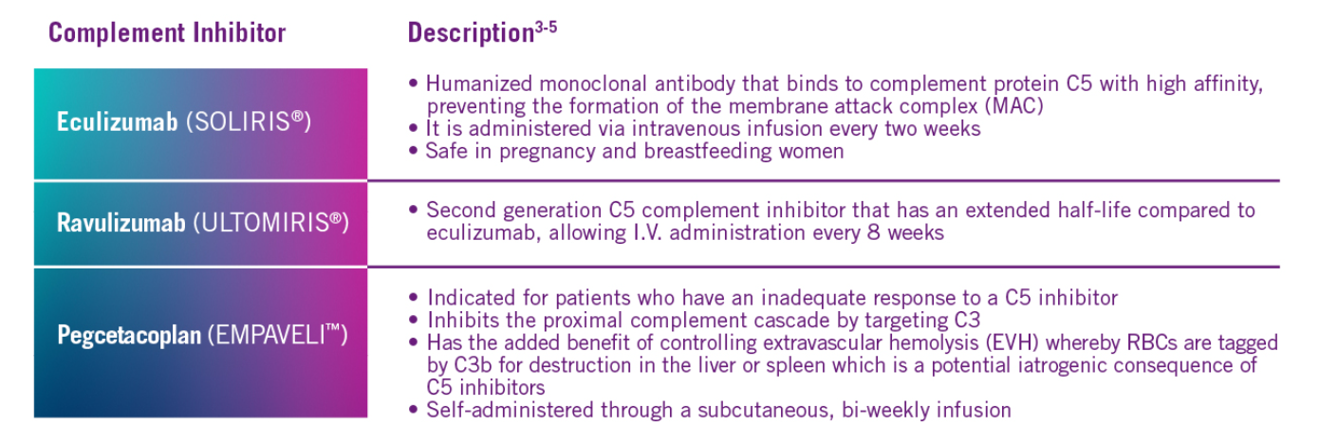
Complement Inhibition – the cornerstone of PNH therapy
Indicated for granulocyte PNH clone size ≥ 10% AND LDH ≥ 1.5x ULN PLUS one of
- anemia / transfusion requirement - chronic renal failure
- symptomatic pulmonary hypertension - thrombosis
- severe abdominal pain from smooth muscle spasm

Slide 24
Question 2:
What is a potentially fatal consequence of anti-C5 therapy?

Slide 25
“The incidence of meningococcal disease in individuals receiving eculizumab is 2.7 to 3.0 per 1000 person-years, and the mortality rate is 0.28 to 0.34 per 1000 person-years in the world. The case-fatality rate of meningococcal disease in eculizumab-exposed individuals is 10% to 11% in the world”
MENINGOCOCCAL VACCINATION IS KEY (serogroups ACWY and B)

Slide 26
Question 3:
What do you expect will happen to the patients PNH clone size once anti-complement therapy is started? How long do you advise the patient they will be on anti-complement therapy?

Slide 27
Anti-complement therapy is not anti-clonal.
PNH clone size does not decrease with anti-complement therapy
Treatment is lifelong

Slide 28
Question 4:
What other supportive care might you offer this patient? Is there a cure for PNH?

Slide 29
Supportive care
Transfusion support- packed red blood cells
Analgesia for abdominal pain or esophageal spasm
Thrombosis
Primary prophylaxis if unable/delay to start complement inhibitor
Therapeutic anticoagulation if history of thrombosis (DOAC, warfarin or heparin)
Allogeneic stem cell transplant
Potential to cure PNH
Reserved for BMF-predominant presentations as can potentially cure AA or MDS and PNH
Almost never employed for classical PNH due to high morbidity and mortality and good efficacy and tolerance of anti-complement therapy
Hematinic support (folate, iron)

Slide 30
Question 5:
The patient is started on eculizumab. After several years on therapy, and they continue to be anemic and require transfusional support with RBCs every 2-3 months. LDH normalized, reticulocytes remain elevated and other blood counts normal, iron and folate replete. What could be going on? What investigations should be done? What treatment could be considered?

Slide 31
Extravascular Hemolysis – a consequence of anti-C5 therapy
Hill et al. Nat Rev Dis Primers 2017

Slide 32
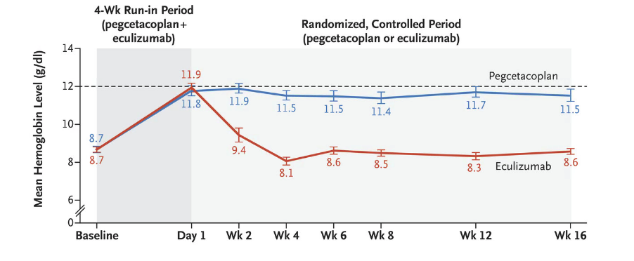
PEGASYS TRIAL
PNH patients on eculizumab
Hb < 105 g/L
≥ 1 transfusion / 12 months
Hillmen et al. NEJM 2022

