Slide 1
Canadian Hematology Society
Since 1971

Slide 2
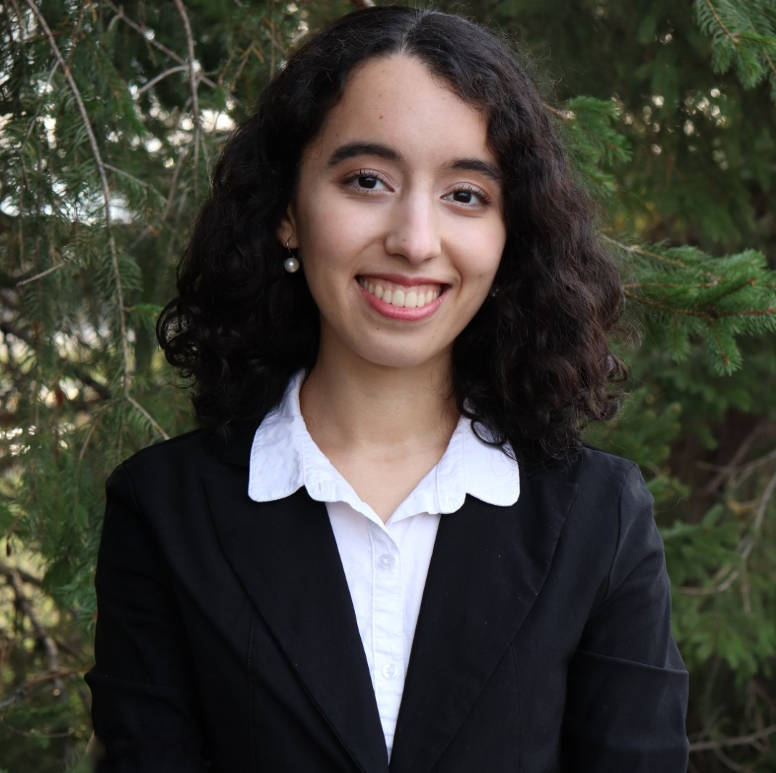
Chief Hematology Resident Dr. Salima Ramdani
Represents Associate members for one year on the CHS Executive Committee and is involved in strategic decision-making for the Society
Participates in Scientific Planning Committee development of continuing education for CHS members
Promotes CHS initiatives on Twitter
Recruits new Associate members
Chief Resident: Dr. Salima Ramdani, PGY4 McGill

Slide 3
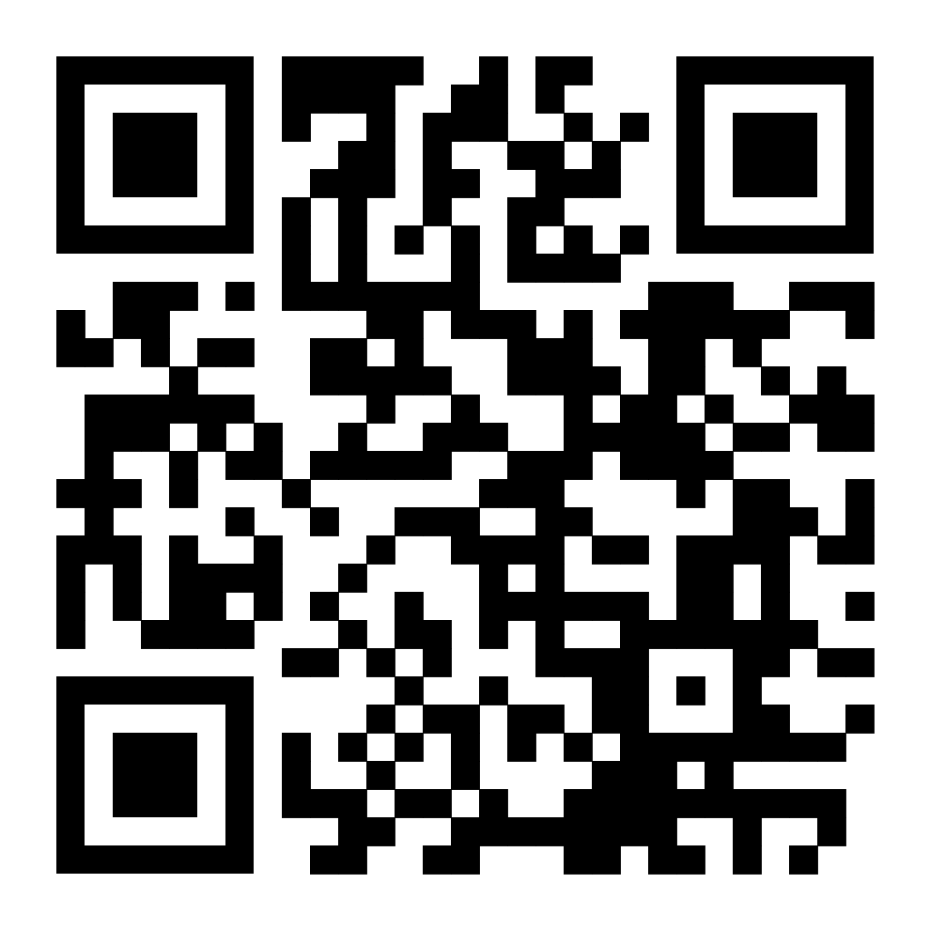
CHS Membership
Joining is free for trainees! After completion of training:$225 a year Application through online form
Members are eligible for many awards and RK Smiley grant
Access to accredited case studies and webinars – earn MOC credits!
Liaison appointed for your suggestions and comments to the Executive Committee

Slide 4
Accredited Case Studies
Free for CHS members
Print a certification upon completion
Over 30 published online in member portal
Pan-Canadian Case Study Challenge – Trainees submit with expert as reviewer
Co-developed with industry sponsors to help with accreditation costs

Slide 5
Pan-Canadian Case Study Challenge
Criteria
Case vignette must be in the field of hematology.
Must contain 4-5 multiple choice questions with at least one source or reference cited per question/answer pair.
Submit online in PDF format
Any member of CHS may submit as the author. There should be an author and a reviewer noted*.
PRIZES awarded! Winner will be announced during the CHS Annual Meeting and Awards event in December
The John H. Crookston Award is presented each year by the Canadian Hematology Society for the best paper given by a resident.
The award is named for the late John Hamill Crookston (1922-1987) who was the Laboratory Hematologist-in-Chief at Toronto General Hospital and a Professor of Medicine and Pathology at the University of Toronto from 1957 until his death in 1987.
The Stephen Couban Award is presented each year by the Canadian Hematology Society for the best abstract given by a Canadian resident in the area of leukemia or stem-cell transplantation.
The award was established in May of 2019 to honour the work of Dr. Stephen Couban who passed away in March 2019. Dr. Couban was a hematologist (Department Head) at the QE II Health Sciences Centre in Halifax, Nova Scotia and served as President of the Canadian Hematology Society from 2012-2014.
Submissions due November 15th

Slide 6
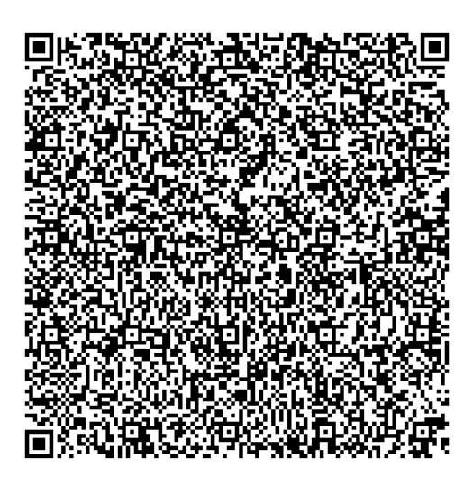
Hematology Horizons: Navigating a Career in Hematology Webinar- June 17, 2025 6:00-7:30 PM ET
Mark Crowther MD MSc LLM FRCPC FRSC Chair and Distinguished University Professor, McMaster University Department of Medicine Leo Pharma Chair in Thromboembolism Research
Joseph R. Shaw MD MSc FRCPC DRCPSC Associate Scientist and Hematologist, Ottawa Hospital Research Institute Assistant Professor in the Faculty of Medicine at the University of Ottawa
Michelle Sholzberg MDCM, FRCPC, MSc. Division Head of Hematology Oncology,Medical Director of Coagulation Laboratory, Director of Hemequity Lab & Hematology-Oncology Clinical Research Group, St. Michael’s Hospital, Hematology Departmental Division Director, Alexandra Yeo Chair in Hematology, Associate Professor, University of Toronto, Scientist, Li Ka Shing Knowledge Institute
Dr. Steven Chan Senior Scientist & Staff Physician, Princess Margaret Cancer Centre Associate Professor, Department of Medicine, University of Toronto
Dr. Francois Mercier Assistant Professor, Department of Medicine, McGill University, Principal Investigator, Lady Davis Research Institute, Attending Physician, Division of Hematology, Jewish General Hospital

Slide 7
Annual Research Abstract Awards
The John H. Crookston Award is presented each year by the Canadian Hematology Society for the best paper given by a resident.
The Stephen Couban Award is presented each year by the Canadian Hematology Society for the best abstract given by a Canadian resident in the area of leukemia or stem-cell transplantation.
The John H. Crookston Award is presented each year by the Canadian Hematology Society for the best paper given by a resident.
The award is named for the late John Hamill Crookston (1922-1987) who was the Laboratory Hematologist-in-Chief at Toronto General Hospital and a Professor of Medicine and Pathology at the University of Toronto from 1957 until his death in 1987.
The Stephen Couban Award is presented each year by the Canadian Hematology Society for the best abstract given by a Canadian resident in the area of leukemia or stem-cell transplantation.
The award was established in May of 2019 to honour the work of Dr. Stephen Couban who passed away in March 2019. Dr. Couban was a hematologist (Department Head) at the QE II Health Sciences Centre in Halifax, Nova Scotia and served as President of the Canadian Hematology Society from 2012-2014.
Submissions due October 31st

Slide 8
Canadian Hematology Paper of the Year Award
Published between September 1st of the previous year and August 31 of the current year.
The award, selected by a review committee, is presented at the CHS Awards ceremony at the Annual Meeting held at ASH each December.
The John H. Crookston Award is presented each year by the Canadian Hematology Society for the best paper given by a resident.
The award is named for the late John Hamill Crookston (1922-1987) who was the Laboratory Hematologist-in-Chief at Toronto General Hospital and a Professor of Medicine and Pathology at the University of Toronto from 1957 until his death in 1987.
The Stephen Couban Award is presented each year by the Canadian Hematology Society for the best abstract given by a Canadian resident in the area of leukemia or stem-cell transplantation.
The award was established in May of 2019 to honour the work of Dr. Stephen Couban who passed away in March 2019. Dr. Couban was a hematologist (Department Head) at the QE II Health Sciences Centre in Halifax, Nova Scotia and served as President of the Canadian Hematology Society from 2012-2014.
Submissions due: September 15th

Slide 9
TRAINEE EDUCATIONAL AND QUALITY IMPROVEMENT AWARDS
$2000 award to be used for the support of their individual research projects
The John H. Crookston Award is presented each year by the Canadian Hematology Society for the best paper given by a resident.
The award is named for the late John Hamill Crookston (1922-1987) who was the Laboratory Hematologist-in-Chief at Toronto General Hospital and a Professor of Medicine and Pathology at the University of Toronto from 1957 until his death in 1987.
The Stephen Couban Award is presented each year by the Canadian Hematology Society for the best abstract given by a Canadian resident in the area of leukemia or stem-cell transplantation.
The award was established in May of 2019 to honour the work of Dr. Stephen Couban who passed away in March 2019. Dr. Couban was a hematologist (Department Head) at the QE II Health Sciences Centre in Halifax, Nova Scotia and served as President of the Canadian Hematology Society from 2012-2014.
Submissions due September 15th
2024-25 Winner: Dr. Renee Potashner
2023-4 Winners:
Dr. Danyal Ladha
Dr. Stefan Jevtic
Eligibility:
Canadian internal medicine residents (PGY1-5)
Hematology residents (PGY 4-5)
Hematology fellows (PGY6+)
Only projects with a focus on education or QI will be considered
CHS member in good-standing

Slide 10
Submit for CHS Hematology Trainee Education and Quality Improvement Awards

Slide 11
Early Career Award – Nominate Someone!
To be eligible for this award, candidates:
Must be a CHS member.
Must be within their first seven years of their initial university or academic appointment (calculation of eligibility can be adjusted for part-time appointments and leaves of absence);
Must hold an academic or independent research appointment at a Canadian institution.
Must demonstrate substantial or meritorious contributions in teaching, quality improvement and patient safety (QIPS) or research (clinical, basic science or translational).
Nomination Process:
Nominations must be submitted by a minimum of two peers (faculty and/or trainee) who must also hold CHS membership. Nominators should clearly identify in their letter the category of academic achievement for which the candidate is being nominated.
In addition to the nomination letters, a letter of support from the Division Chief or Department Chair should be included.
The John H. Crookston Award is presented each year by the Canadian Hematology Society for the best paper given by a resident.
The award is named for the late John Hamill Crookston (1922-1987) who was the Laboratory Hematologist-in-Chief at Toronto General Hospital and a Professor of Medicine and Pathology at the University of Toronto from 1957 until his death in 1987.
The Stephen Couban Award is presented each year by the Canadian Hematology Society for the best abstract given by a Canadian resident in the area of leukemia or stem-cell transplantation.
The award was established in May of 2019 to honour the work of Dr. Stephen Couban who passed away in March 2019. Dr. Couban was a hematologist (Department Head) at the QE II Health Sciences Centre in Halifax, Nova Scotia and served as President of the Canadian Hematology Society from 2012-2014.
Submissions due September 15th

Slide 12
Communication
Job and Fellowship Postings
Monthly email newsletter
Job and Fellowship Postings online
Resources online for members: webinar and case study library

Slide 13
Voice
Review by Board for supporting projects or CADTH reviews
Board member part of RCPSC sub-specialty committee, hematology
Board member working with Canadian Blood Services – transfusion group
Special interest groups

