Slide 1
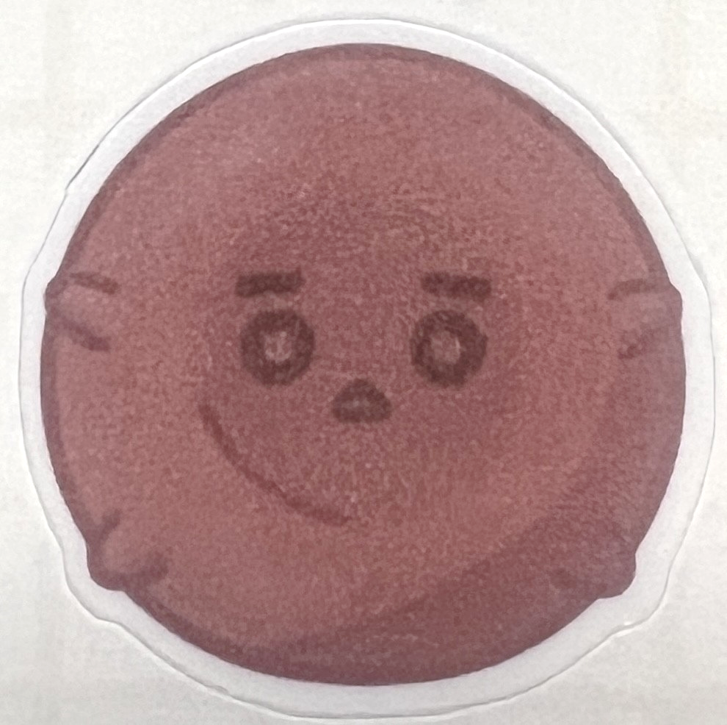
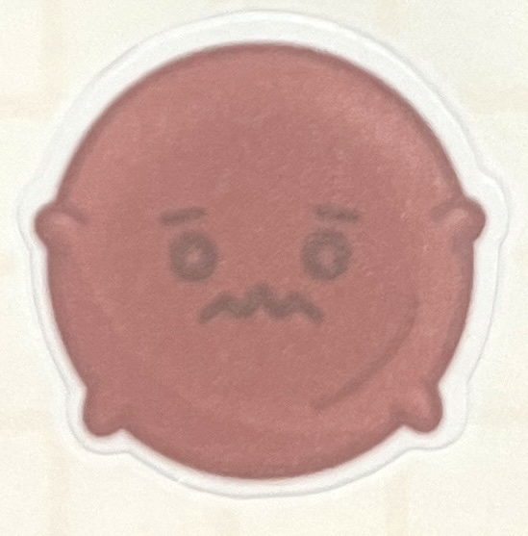
Optimizing the Management of Iron Deficiency Anemia in the Emergency Room
Renee Potashner MD FAAP FRCPC
Project Team: Felicia Paluck MD, Deborah Schonfeld MD, Andrea Boysen RN, Vincent Lam PharmD RPh, Jeffrey Lai PharmD ACPR RPh, Jodie Odame MBBS MSc, Caroline Malcolmson MD MSc, Olivia Ostrow MD, Reena Pabari MD MSc
This project is supported by The Canadian Hematology Society Trainee Education and Quality Improvement Award.
Notes:
Good afternoon everyone. I am excited to share our ongoing quality improvement project entitled “optimizing the management of iron deficiency anemia in the ER”, supported by the CHS trainee education and quality improvement award.

Slide 2
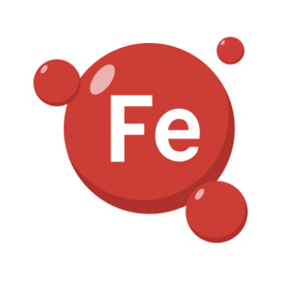
Why does it matter?
Iron deficiency is the most common nutrient deficiency worldwide with IDA affecting 5-25% of Canadian children
No standard guidelines are in place for managing IDA in our ER, leading to variable management on a case-by-case basis depending on who is working that shift
Notes:
Iron deficiency is the most common micronutrient deficiency worldwide with prevalence estimates ranging from 5 to 25% of Canadian children. Although some published management guidelines do exist, we do not currently have a standard practice guideline in our ER. This results in the management varying on a case-by-case basis, depending on who is working in the ER that day and which hematologist is on call. While we know that the treatment of IDA requires addressing the underlying cause and repleting iron, this was not always happening for patients seen in the ER.
[click]
Over the past year we identified 165 patients who were suitable for our project, excluding more complex cases of anemia such as after bone marrow or solid organ transplant, those with hemoglobinopathies, or anyone with known GI malabsorptive conditions.
This SPC chart on the left demonstrates that only 33% of these patients received either oral or IV iron therapy. When stratifying by anemia severity, [click] it is evident that those with mild or moderate anemia were more likely to have no iron-specific therapy administered. Additionally, only about 25% of patients were instructed to follow up with their primary care doctor to further evaluate the anemia.
[click – next slide]

Slide 3
What will we do?
Aim: To increase the proportion of patients aged 1-18 seen in the ED with iron deficiency anemia who receive any form of iron replacement (oral or intravenous) from the current baseline rate of 33% to 50% by October 2025.
Standardize management based on best-practice consensus
Provide education to prescribers and nurses on IDA management
Partner with patients and families
Notes:
We therefore set an aim to increase the proportion of patients seen in the ER with iron deficiency anemia who received iron placement from 33% up to 50% by October 2025.
[click]
Through a more detailed analysis of our baseline chart review, we identified three main root causes that we plan to address with our intervention. First - that the diagnosis of IDA was not prioritized or addressed, because patients had presented with another complaint during the ER visit. Second – that the anemia was recognized and documented, but the management was not optimal , and third – that iron had been previously prescribed, but there were challenges with adherence. Based on this, our team focused our interventions around these three themes: [click] creating a standardized management plan,[click] providing education to the healthcare team, and [click] partnering with patients and their families.

Slide 4
How will we do it?
Intervention | Process Measure
Standardized order set Distinct for each age group With Clinical Decision Support | % encounters order set used % guideline-concordant orders
Clinical Team Education Promote awareness of guidelines Increase comfort in prescribing and monitoring iron | Change in prescriber knowledge after education session (pre- and post- survey)
Patient and Family Education Standardized discharge materials Translations into top 3 languages | % encounters where instructions are provided at discharge % patients prescribed PO iron demonstrating 4/5 understanding of instructions (questionnaire at first Haematology follow up) % patients prescribed PO iron with >90% compliance (questionnaire at first Haematology follow up)
Notes:
While our work is in progress, we are planning to introduce standardized order sets with embedded clinical decision support. We will provide training to clinical team members to promote awareness of existing guidelines and hopefully increase comfort in prescribing and administering iron. Lastly, we are creating standardized teaching materials to share with families upon discharge to promote knowledge and understanding of their lab results, modifiable risk factors and strategies to support medication adherence. We plan to translate these into the top 3 non-English languages of our patient population to further promote information sharing and facilitate continuity of care with their primary care team.
So far, we have identified that IDA is often underrecognized and undertreated in the SK ER, especially for patients with mild or moderate anemia. Our intervention has the potential to decrease blood transfusion utilization, reduce admissions, and reduce the need for subspeciality follow up care. I look forward to sharing updates as we iterate and implement our interventions.

