Slide 1
Monoclonal Gammopathies of Clinical Significance
June 7th, 2025
Christopher Cipkar, MD, FRCPC
Hematologist, Plasma Cell Disorders Program
The Ottawa Hospital
E-mail: ccipkar@toh.ca

Slide 2
Disclosures
Relationships with commercial interests:
Grants/Research Support: None
Speakers/Honoraria: Pfizer, Forus Therapeutics
Consulting fees: None
Other: None

Slide 3
Objectives
1. How we define monoclonal gammopathies
2. Monoclonal gammopathies of renal significance
3. Monoclonal gammopathies of neurological significance
4. Monoclonal gammopathies of cutaneous significance
5. Return to case
6. Questions

Slide 4
Case
Nephrology refers a 52yo male with nephrotic range proteinuria.
Renal biopsy shows proliferative glomerulonephritis with monoclonal IgG deposits (PGNMID) and mild to moderate interstitial fibrosis.
SPEP (IFE negative) and serum free light chains are normal.
24hr urine shows 10 g total protein per day (mostly albumin)

Slide 5
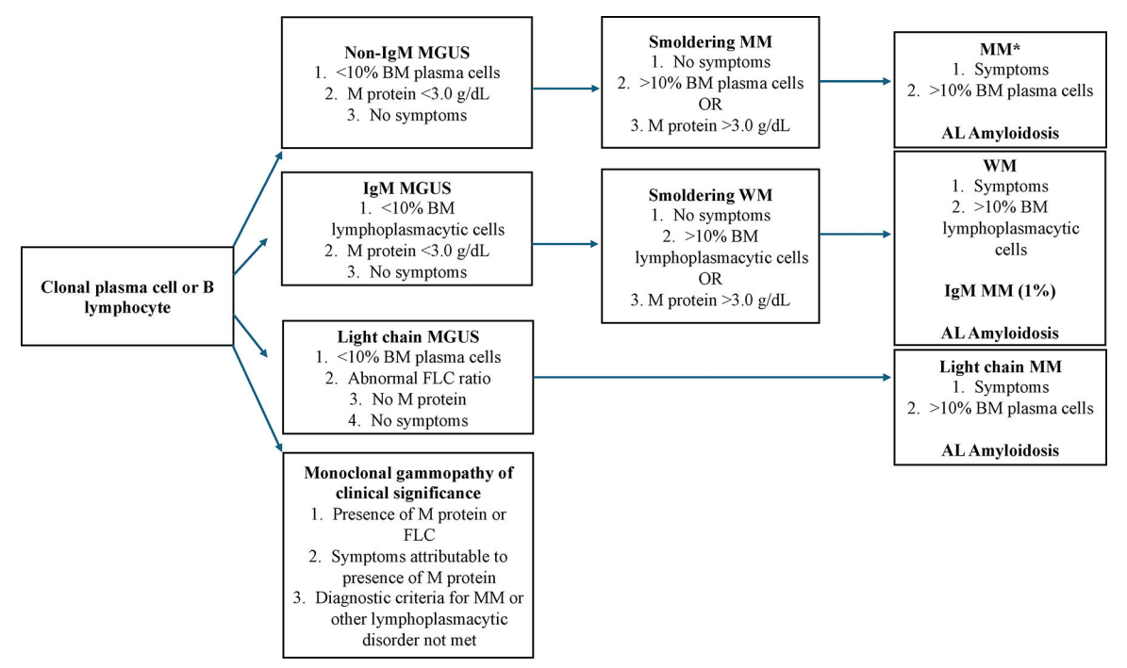
Definitions
Plasma Cell Disorders
Symptomatic
Liu et al. JAMA Intern Med 2025

Slide 6
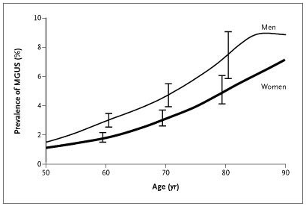
Definitions
MGUS is a premalignant, clonal PC disorder characterized by the presence of an M-protein produced by a small B-cell/PC clone in persons without features of symptomatic disease related to malignant disorders.
Kyle et al. NEJM 2006
*There are currently no recommendations/guidelines to screen asymptomatic individuals for MGUS*
Notes:
iStopMM and PROMISE trials are testing utility of screening

Slide 7
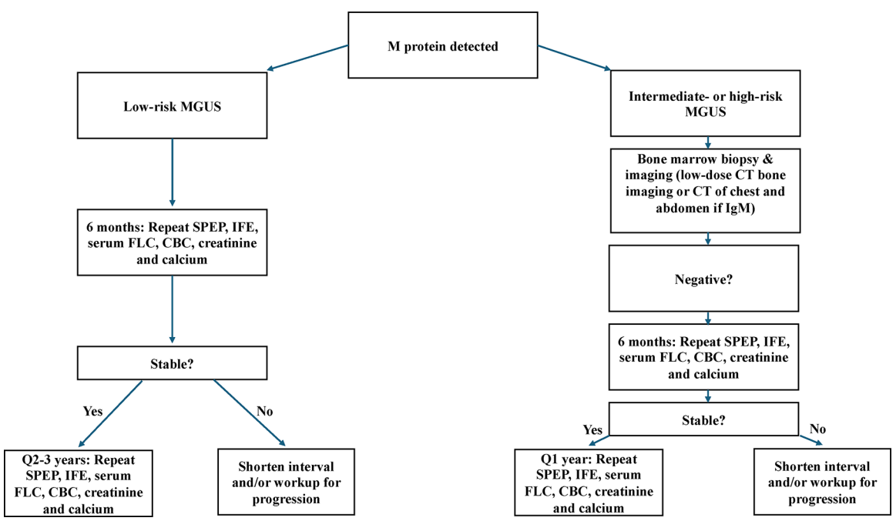
Definitions
Baseline for all
CBC
Ca, Creatinine
SPEP + IFE
SFLC
Immunoglobulins
24hr UPEP
Liu et al. JAMA Intern Med 2025

Slide 8
Definitions
MGRS was described for the first time in 2012. MGRS is basically defined as a kidney disease related to the presence of an M-protein, diagnosed by demonstration of monoclonal deposits in the kidney biopsy. Monoclonal deposits can consist of monoclonal LC, heavy chain, or intact Igs. Restriction to a single class of LC and/or heavy chain is mandatory
MGCS is a heterogeneous group of nonmalignant MGs featuring two main characteristics (concept introduced in 2018): the presence of a clone, which is commonly associated with the secretion of an M-protein, and symptoms that can be related to the M-protein or to the clone itself by different mechanisms that do not include tumor burden.
most common of which are kidney, nerve, and skin
Notes:
The key difference between MGUS and MGCS is the presence of disease or organ damage associated with the M-protein or to the clone itself, with therapeutic implications in the last one. Therefore, individuals with MGUS are asymptomatic, without organ damage attributable to the clone or the M-protein, and without the need for treatment, whereas patients with MGCS are symptomatic, organ damage associated with the clone itself or the M-protein can be confirmed, and treatment is needed

Slide 9
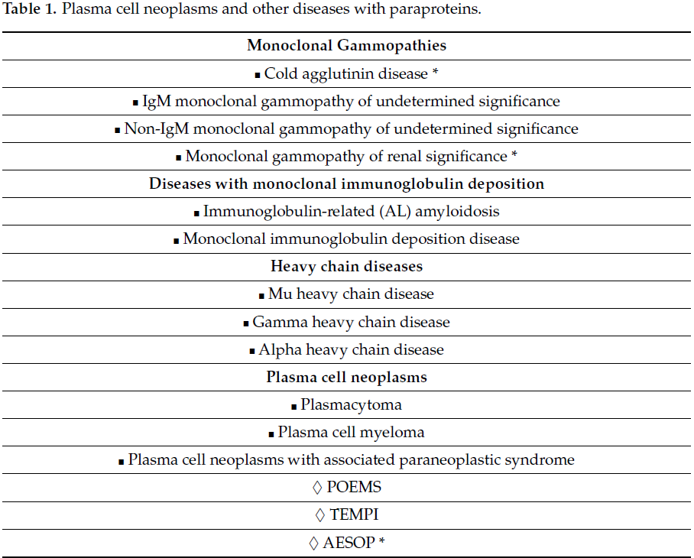
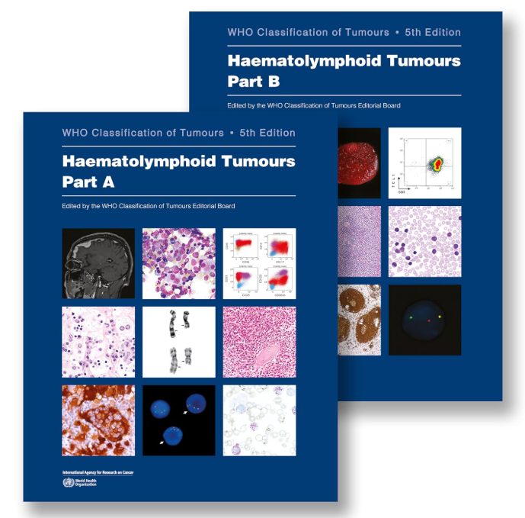
Definitions
WHO-HAEM5 (2022)

Slide 10
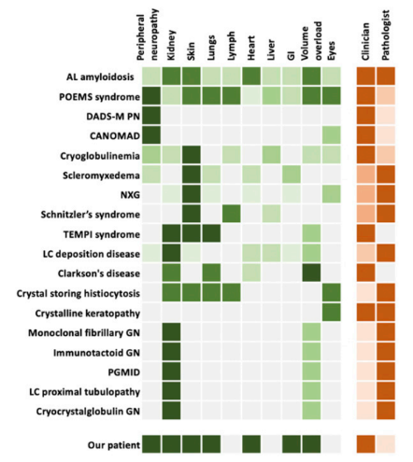
Monoclonal Gammopathy of Clinical Significance
Dispenzieri ASH Education Program 2020

Slide 11
Monoclonal Gammopathy of RENAL Significance

Slide 12
Monoclonal Gammopathy of Renal Significance
Prevalence
Shaik et al. reported a prevalence of MGRS of 6% in individuals diagnosed with MGUS in the United States (Blood 2014)
Steiner et al. reported a prevalence of 1.5% of MGRS in 2935 patients diagnosed with MGUS (Oncotarget 2017)
Notes:
16. Shaik M, Al-Janadi A. Long Term Survival of Monoclonal Gammopathy of Renal Significance (MGRS): An Analysis of Nhanes III. Blood 2014;124(21):4849.
17. Steiner N, Gobel G, Suchecki P, Prokop W, Neuwirt H, Gunsilius E. Monoclonal gammopathy of renal significance (MGRS) increases the risk for progression to multiple myeloma: an observational study of 2935 MGUS patients. Oncotarget 2017 Dec 18;9(2):2344-2356.

Slide 13
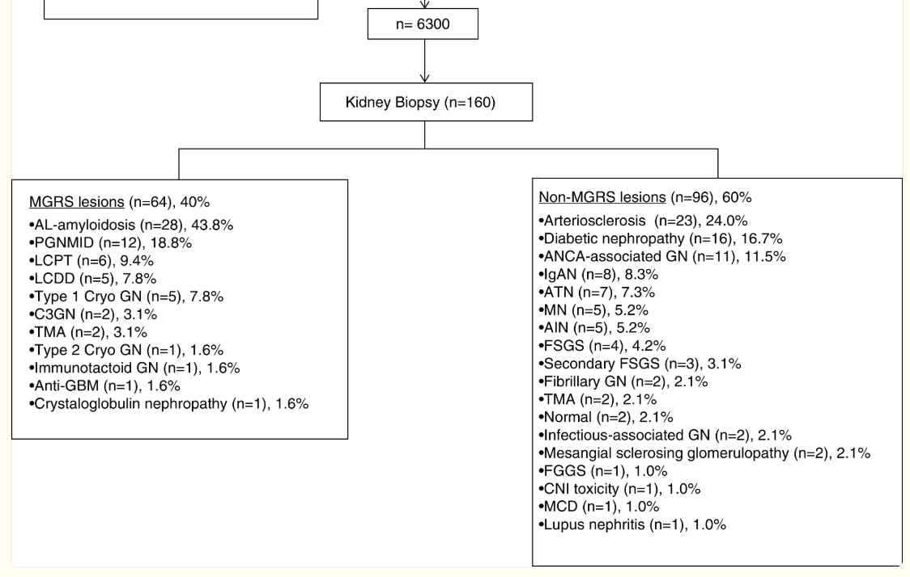
Monoclonal Gammopathy of Renal Significance
Klomjit et al. J Am Soc Nephrol. 2020

Slide 14
Monoclonal Gammopathy of Renal Significance

Slide 15
Monoclonal Gammopathy of Renal Significance
Diagnosis
Have a high degree of awareness in patients with monoclonal gammopathy (especially if > 1.5 g/day proteinuria, abn FLC, or hematuria)
Nephrology specialty involvement
Need a renal biopsy to diagnose MGRS
Identify the underlying B-cell, plasma cell or lymphoplasmacytic clone (Not always possible!): BM biopsy, peripheral flow cytometry, pan-CT scans

Slide 16
Monoclonal Gammopathy of Renal Significance
Clinical Importance
Renal function declines in MGRS patients with a potential to progress to ESRD
Clone-directed therapy using novel chemotherapeutic combinations results in improved renal survival
Recurrence after renal transplantation has been documented in MGRS patients in whom incomplete hematological remission was achieved before renal transplant

Slide 17
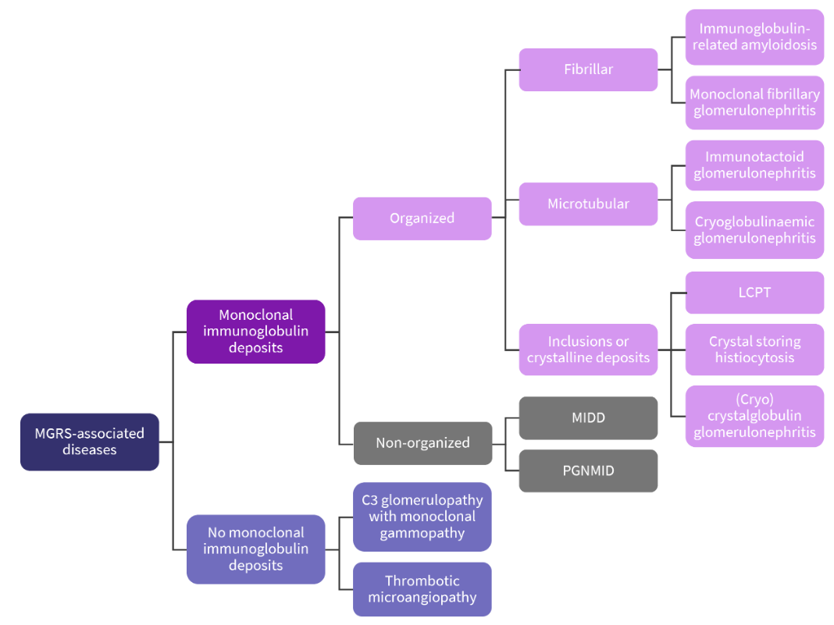
Monoclonal Gammopathy of Renal Significance
Need input from nephrologist
and renal pathologist!

Slide 18
Monoclonal Gammopathy of Renal Significance
Management
Except for AL amyloidosis, there are currently no evidence-based recommendations
Goals: preserve or improve organ function by targeting the B-cell or plasma cell clone that is responsible for production of M-protein and organ damage (“clone-directed therapy”)
PC clone → CyBorD, daratumumab + supp care
B-cell clone → Rituximab + supp care
Sometimes expectant management is also okay (< 1g/day proteinuria or if they are already dialysis-dependent)

Slide 19
Monoclonal Gammopathy of NEUROLOGICAL Significance

Slide 20
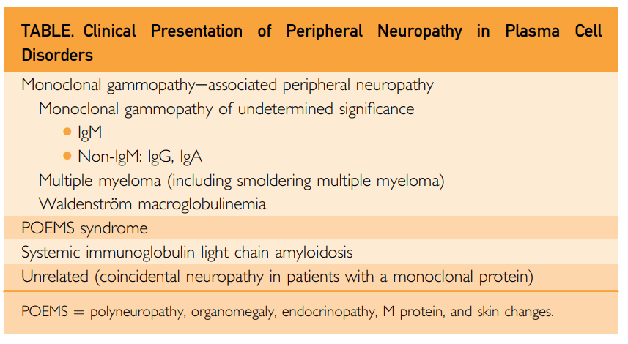
Monoclonal Gammopathy of Neurological Significance

Slide 21
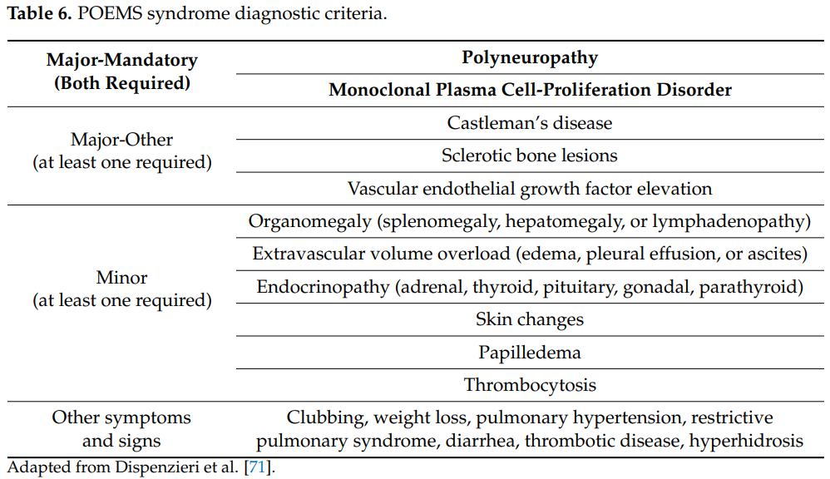
Monoclonal Gammopathy of Neurological Significance
Progressive chronic demyelinating sensorimotor polyneuropathy that is either length dependent or a polyradiculoneuropathy and is often mistaken for CIDP

Slide 22
Monoclonal Gammopathy of Neurological Significance
AL Amyloid Neuropathy
Peripheral neuropathy occurs in 15-20% of patients with AL amyloidosis
Neuropathy is the dominant presentation of the disease among only 25% of such patients
The neuropathy is often length dependent and associated with burning, pain, and numbness. Upper limb involvement is common (carpal tunnel syndrome)
The neuropathy in AL amyloidosis often has an axonal pattern
Autonomic function also tends to be impaired in neuropathy associated with AL amyloidosis

Slide 23
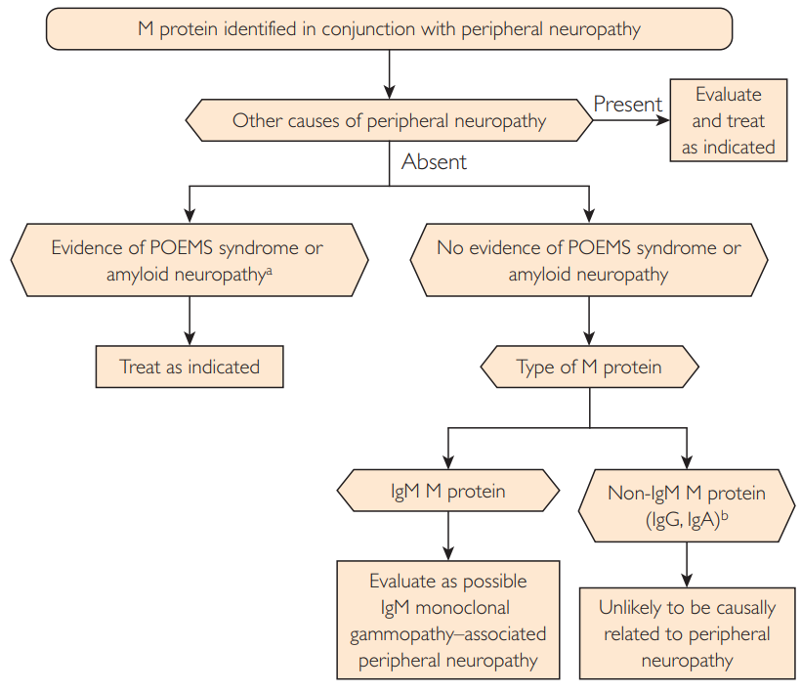
Monoclonal Gammopathy of Neurological Significance
Chaudhry et al. Mayo Clinic Proceedings 2017

Slide 24
Monoclonal Gammopathy of Neurological Significance
DADS-M
Patients are more often male and in their 50s to 80s.
They present with a distal, demyelinating symmetric neuropathy. Sensory ataxia is the most common sign.
The diagnosis is one of exclusion
Anti-MAG antibodies can be detected in approximately 50% of patients with IgM M-protein related peripheral neuropathy (specificity is low)
Management involves IVIG, plasmapheresis, or rituximab? (anti-MAG positive)

Slide 25
Monoclonal Gammopathy of Neurological Significance
CANOMAD
Very rare!
Characterized by a chronic neuropathy with sensory ataxia and IgM disialosyl antibodies.
Patients may or may not have motor weakness involving oculomotor and bulbar muscles or cold agglutinins.
Both axonal and demyelinating patterns have been recognized
The most effective therapies are IVIG, rituximab, and plasmapheresis

Slide 26
Monoclonal Gammopathy of CUTANEOUS Significance

Slide 27
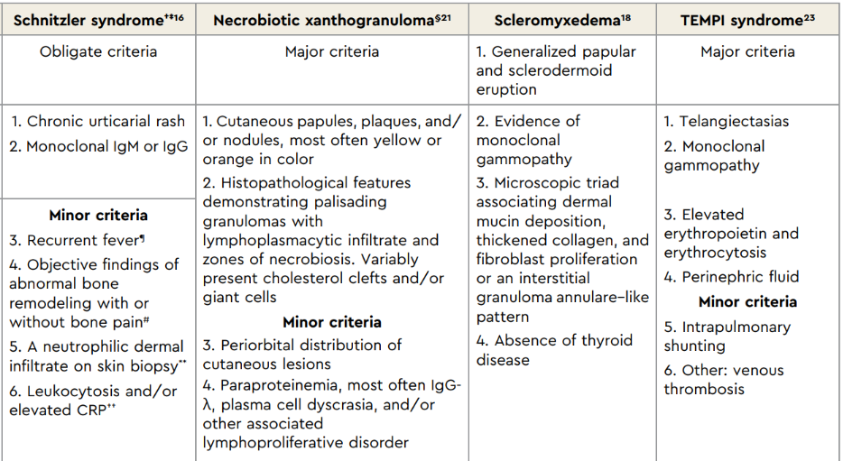
Monoclonal Gammopathy of Cutaneous Significance

Slide 28
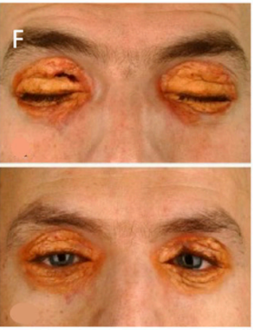
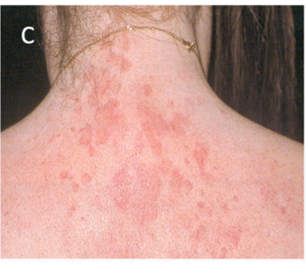
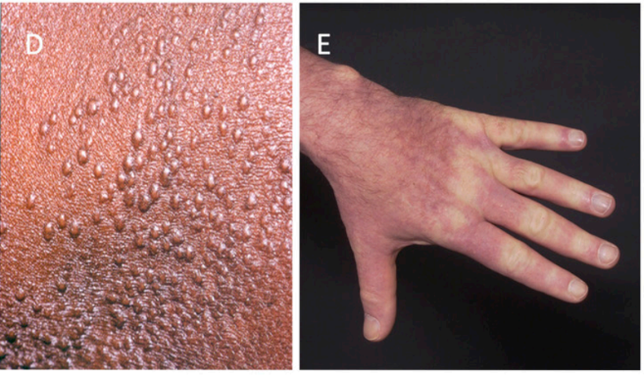
Monoclonal Gammopathy of Cutaneous Significance
Schnitzler Syndrome
Scleromyxedema
Necrobiotic Xanthogranuloma

Slide 29
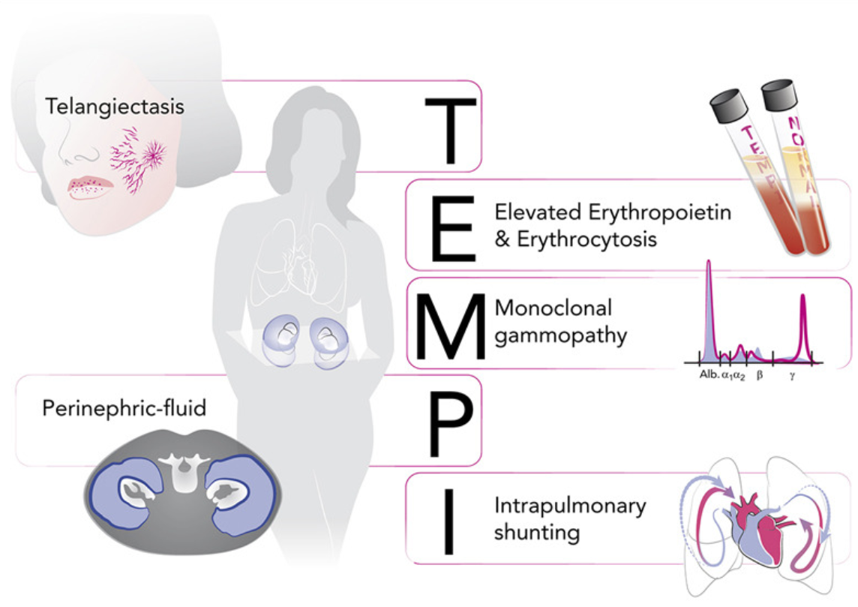
Monoclonal Gammopathy of Cutaneous Significance

Slide 30
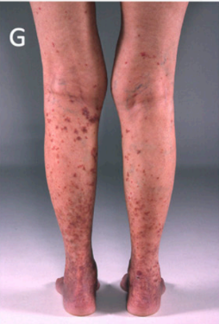
Monoclonal Gammopathy of Cutaneous Significance
Type I cryoglobulins arise from clonal
plasma cell proliferative disorders or lymphoproliferative disorders (<1/3 renal involvement, but ~50% have peripheral neuropathy)
Mixed cryoglobulinemia (Type II/III) may be related to PCDs or LPDs but are more often due to infections such as hepatitis C virus and connective tissue disorders (skin symptoms!)
Cryoglobulinemia vasculitis

Slide 31
Monoclonal Gammopathy of Cutaneous Significance
Management

Slide 32
Case
Nephrology refers a 52yo male with nephrotic range proteinuria.
Renal biopsy shows proliferative glomerulonephritis with monoclonal IgG deposits (PGNMID) and mild to moderate interstitial fibrosis.
SPEP (IFE negative) and serum free light chains are normal.
24hr urine shows 10 g total protein per day (mostly albumin)
Bone marrow biopsy and peripheral flow showed no clonal B-cells or light chain restricted plasma cells. Pan-CTs negative.

Slide 33
Case
Rituximab 375 mg/m2 IV weekly x 4 doses
CyBorD x 6 months
CyBorD x 6 months
24hr urine protein
Time

Slide 34
Clinical Pearls
MGUS is common. So are peripheral neuropathy and albuminuria. MGCS are uncommon. Have a high degree of awareness.
MGRS requires a renal biopsy!
All other MGCS require a clinicopathologic diagnosis. Involve other experts like nephrology, neurology and dermatology.
Other than AL amyloidosis, there are no evidence-based recommendations on how to manage MGCS (just expert consensus)
Refer for second opinion as needed

Slide 35
Discussion
Contact: e-mail ccipkar@toh.ca, fax 613-739-6662, phone 613-737-8899 x 71281

